Slide 1


NEXT GEN EMPLOYABILITY PROGRAM
CREATING A FUTURE-READY WORKFORCE
Student Name :
Chikirigalla Paramesh
Student ID :
STU655b4d5a438cb1700482394
Mobile No :
830980529
Mail ID :
paramesh96255@gmail.com
College Name :

Slide 2
CAPSTONE PROJECT SHOWCASE
Project Title
Health Care Data Driven Decisions using Power BI
Abstract | Problem Statement | Project Overview | Proposed Solution | Technology Used | Modelling & Results | Conclusion | Q&A

Slide 3
Abstract
1
Import data to Power BI form various data sources and pre-processed it.
2
By using DAX-Functions we are created new columns for effective Analysis.
3
Cards and slicers are created for representing a single value of data.
4
By using visualization tools we are represented that what is really happening in these raw data and we got the insights from it.

Slide 4


Problem Statement
In which day most number of patients are visiting the hospital in a week ?
Calculate total patients that so far how many members visited?
Calculate the how much percentage does male,female has in total patients?
What is patient Average duration of stay in hospital?
Which age group people visits the hospital most?

Slide 5

Project Overview
Data collection, Importing and pre-processing
Dax Functions : New Columns, New Measures
Visualization Dashboard
Formatted & Tested
Saved & Shared

Slide 6
Proposed Solution
By using Bar chart we are conclude that which day more number of patients are visiting.
Using card visual we are knew the total patients count by measure data.
Dividing the respective count by total count so that we can get the percentage of the value.
With Duration of the hospital column using DAX Functions we will get average count of the hospital.
we knew the patients data by age group using clustered bar chart.

Slide 7
Technology used
Power BI

Slide 8
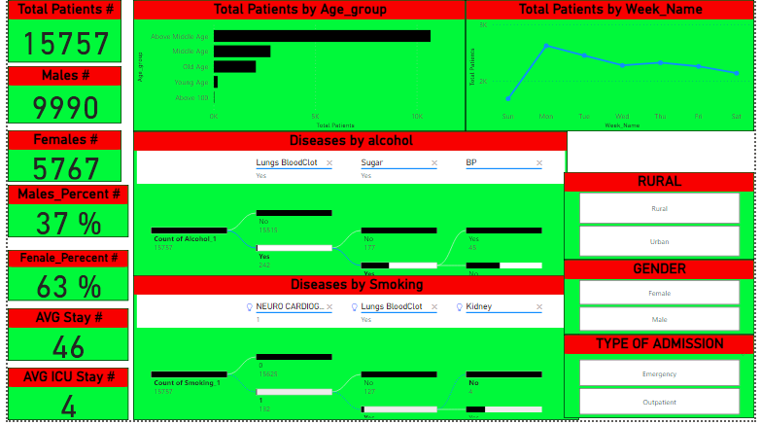
Dashboard 1

Slide 9
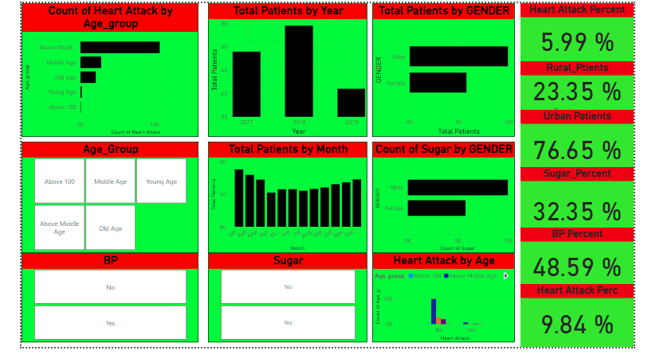
Dashboard 2

Slide 10
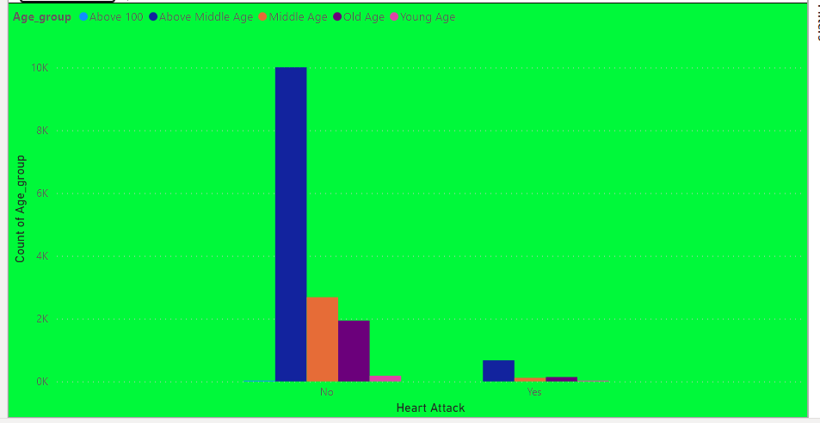
Patients having Heart attack by age group

Slide 11

Conclusion
By these Health Care Data Driven Decisions using Power BI i knew how to analyze the huge raw data and how to get useful insights by using various visualisation tools from the data.
Finally i would like to say thanks to Next Gen Empployability team members.

Slide 12


Notes:
Thank You !!

